Slide 1
TEAM 4 PROJECT:
OPLS(Oracle Public Libraries System)

Slide 2
Brief overview of the project
The Oracle Public Libraries System handles libraries that serve all members of a community by providing a service where people of all ages can check out items like book, CDs, DVDs….
Employees or Librarians will be able to store items information, approve room’s reservation, proceed with check ins, keep track of fines….
Regular customers will be able to check out and check in items, reserve rooms for different purposes, pay fines…..

Slide 3
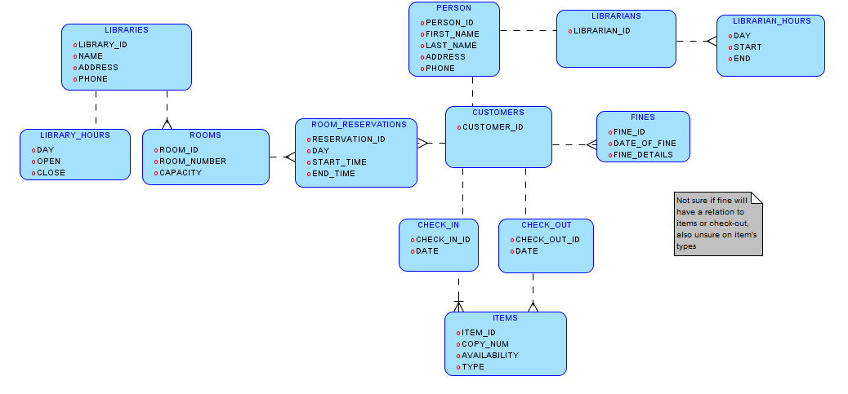
Logical Model with entities and relations
Screen clipping taken: 11/7/2013 11:43 AM

Slide 4
Set of Business Rules
The Libraries will provide these 5 items: Books, DVDs, CDs, tapes and their electronic counter parts.
Customer (including employees) can reserve items and rooms, check in /out items, incur fines, and pay fines.
Customers can check out a maximum of 10 items.
Customers cannot check out items or reserve rooms if there is an incurred fine balance remaining
The libraries database will only be accessible during business hours (Monday thru Saturday from 8:00 am to 5:00 pm). That means after hours nobody would be able to check books and reserve rooms.
All items checked out must be returned after 2 weeks.
If not returned after 2 weeks, warning message will be sent to the person who checked out the book.
48 hours after receiving the warning message, if the book is still not returned fines will be applied.
Fines are equal to $0.20 / day, up to the full retail price of the book.
Employees will be responsible for handling item checkouts, check ins, approving reservations and fine processing.
Rooms may be reserved for any customer for a span of time. No two reservations may overlap.
Room reservations have time limits dependent on the type of room: i.e., study rooms have a max time of 2 hours, event rooms have a max time of 4 hours, etc.

Slide 5
Check ins and check outs will be handled for a single customer with one or multiple items where a librarian will handle it.
A library card can be assigned to a customer (employees included) and can only be used by the original library card holder for reserving rooms and checking out items.
Items that are not returned after 2 months are labeled as lost by the librarian.
Librarians can also report if an item is damaged, available, checked ­out, or late.

Slide 6
Functional Requirements
There are seven type of processes that will be handled by the database.
Any employee must be able to retrieve information on customer that includes customer information, item checkout history and fines,
[Query Room] Any employee or customer may retrieve information on a room regarding its reservation status that includes the room, library, and schedule for the room for a specified timespan,
[Checkout] This process changes the status of an item and adds information for customer stating that a book has been checked out under the customer on what date, when the item is due, and increments the customer’s number of checked out items. Libraries are responsible to handle the checkout process.
[Return] It changes the status of an item and changes the information that is linked to the customer stating that the item is checked in on what day. A librarian is require to handle the check-in process.
[Reserve Room] This process changes the schedule for a room and must be approved by a librarian before being committed to the database
[Generate Fines] Items that have not been returned past their due dates will incur fines for the customer holding the item.
[Pay Fines] Customers are able to pay fines at any libraries where a librarian will handle the process. The database is to save the transaction and receipt given to the customer.
Briefly: Retrieve customers info by employees, checkout items, return items, reserve rooms, generate and pay fines.

Slide 7
Technology Used
The database’s GUI will be built based on the Java Language and use Swing components. It will be hosted on Oracle with a schema name of “LIBDB.” Users can interface with it through a .jar executable installed on computer kiosks and systems within the library building. This allows it to be portable on all the computers.
Our database will use several pieces of software to contribute to its development. Oracle’s Data Modeler will be used to create the ERD, and SQL Developer / Netbeans will be used to create the procedures in PL / SQL and Java with Swing APIs. Sharing files and folders will use a custom Github repository and Google Docs / Google Drive for text documents. Currently, while the Github repository is being created, Dropbox will be used as a temporary solution to work with the ERD, with plans to migrate to Github.

